Slide 1


7/26/24
DA-IICT
IT 314: Software Engineering
User Stories & Acceptance Criteria
Saurabh Tiwari
1
User Stories
seek to combine the strengths
of written and verbal communication, where possible supported by a picture.

Slide 2
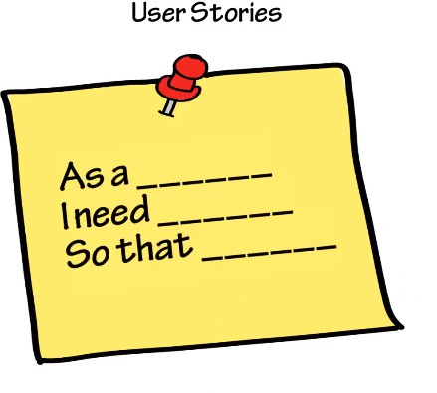

7/26/24
User Story
A user story is a tool used in Agile software development to capture a description of a software feature from an end-user perspective.
The user story describes the type of user, what they want and why.
A user story helps to create a simplified description of a requirement.
Agile reduces the risk by delivering the value of the project very early
Specification - User Stories

Slide 3
7/26/24
User Story Description
As a [user role] I want to [goal] so I can [reason]
For example:
As a registered user I want to log in so I can access subscriber-only content
User Story Description
Who (user role)
What (goal)
Why (reason)
gives clarity as to why a feature is useful
can influence how a feature should function
can give you ideas for other useful features that support the user's goals

Slide 4
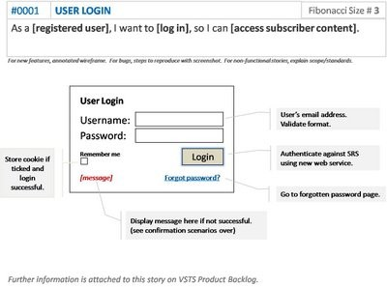
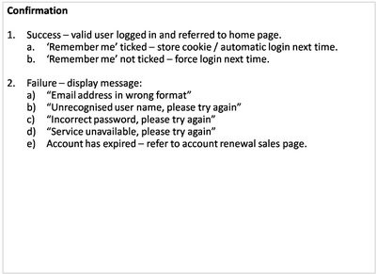
7/26/24
User Story Example: Front of Card
User Story Example: Back of Card

Slide 5
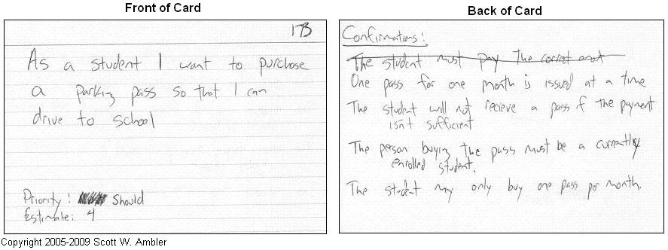
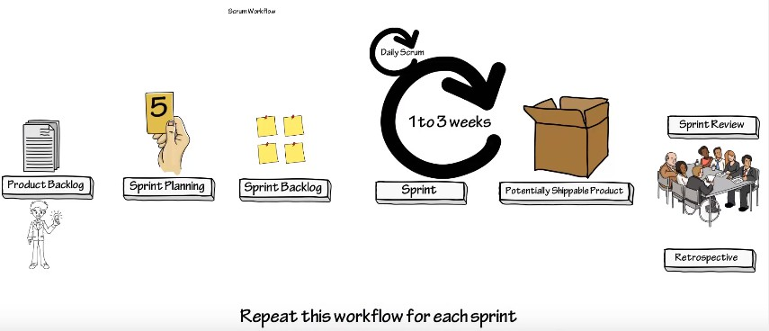

7/26/24
User Story Card
SCRUM

Slide 6

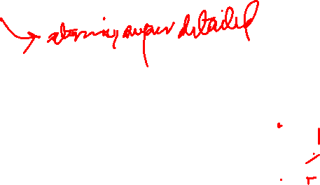
7/26/24
How detailed should a User Story be?
Detailed enough for the team to start work from, and further details to be established and clarified at the time of development.
How detailed should a User Story be?
One of the benefits of agile user stories is that they can be written at varying levels of detail.
Here is an epic agile user story example from a desktop backup product:
As a user, I can backup my entire hard drive.
The epic above could be split into dozens (or possibly hundreds), including these two:
As a power user, I can specify files or folders to backup based on file size, date created and date modified.
As a user, I can indicate folders not to backup so that my backup drive isn't filled up with things I don't need saved

Slide 7
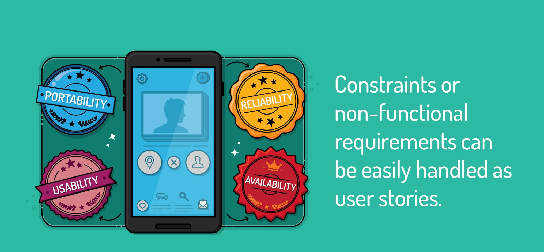
7/26/24
Non-functional Aspects
think of non-functional requirements as “constraints” we put on the system. When a product owner says, “this system must perform adequately with 100,000 concurrent users,” the product owner is putting a constraint on the development team.
As a customer, I want to be able to run your product on all versions of Windows from Windows 95 on.
As the CTO, I want the system to use our existing orders database rather than create a new one, so that we don't have one more database to maintain.
As a user, I want the site to be available 99.999 percent of the time I try to access it, so that I don't get frustrated and find another site to use.
As someone who speaks a Latin-based language, I might want to run your software someday.
As a user, I want the driving directions to be the best 90 percent of the time, and reasonable 99 percent of the time.

Slide 8
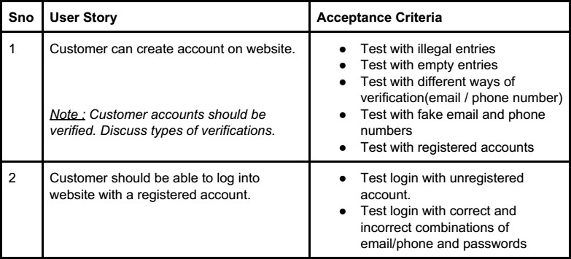
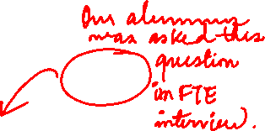
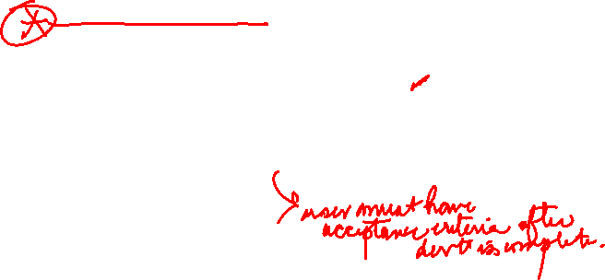
7/26/24
Example
Nirjhar Bala
Evivehealth
TASK: To create small user stories having all possible roles and tasks of a QA for an ecommerce website
FUNCTIONALITY: Customer can purchase items from the website.
RULES TO PONDER/ASSUMPTIONS
All the stories that have been broken down are mostly independent , hence making sure that they can be parallelly developed.
Not every minute detail has been included in the cards, encouraging
developers to seek further clarification and ensuring negotiability.
Stories have been written in regular business language that is equally valuable to both stakeholders and developers.
It is assumed that all the user stories mentioned below can be converted into working pieces of code within the working period of 1 to 3 weeks and hence are estimable and small.
It is also written in a way where the completion of the story and its working is quantifiable and can be tested, hence being testable.
Example….
Other user stories and their acceptance criteria…

